Slide 1




The ACNEI Computational Neuroscience Introductory School
Learning in the Brain (Neuroplasticity)
TA name here
12-05-2026
acnei.org

Slide 2


The ACNEI Computational Neuroscience Introductory School
SESSION OBJECTIVES
01
The Neuron: Structure & types
02
Electrical properties of a Neuron
03
Neuron Spikes
04
Learning in the Brain
05
Long term Potentiation
acnei.org

Slide 3
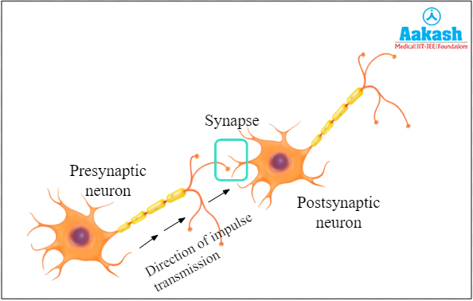
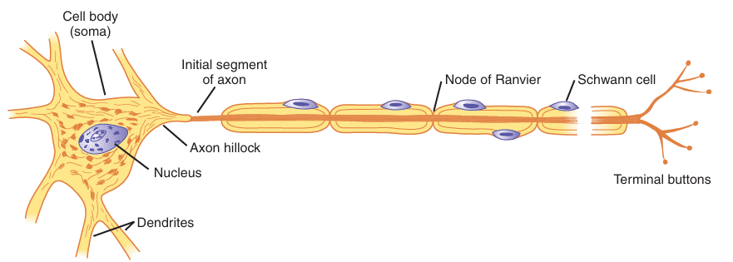
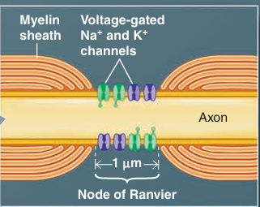
The ACNEI Computational Neuroscience Introductory School
THE NEURON
Structure of a Neuron
Direction of impulse across axon
Structure of node of Ranvier
acnei.org

Slide 4
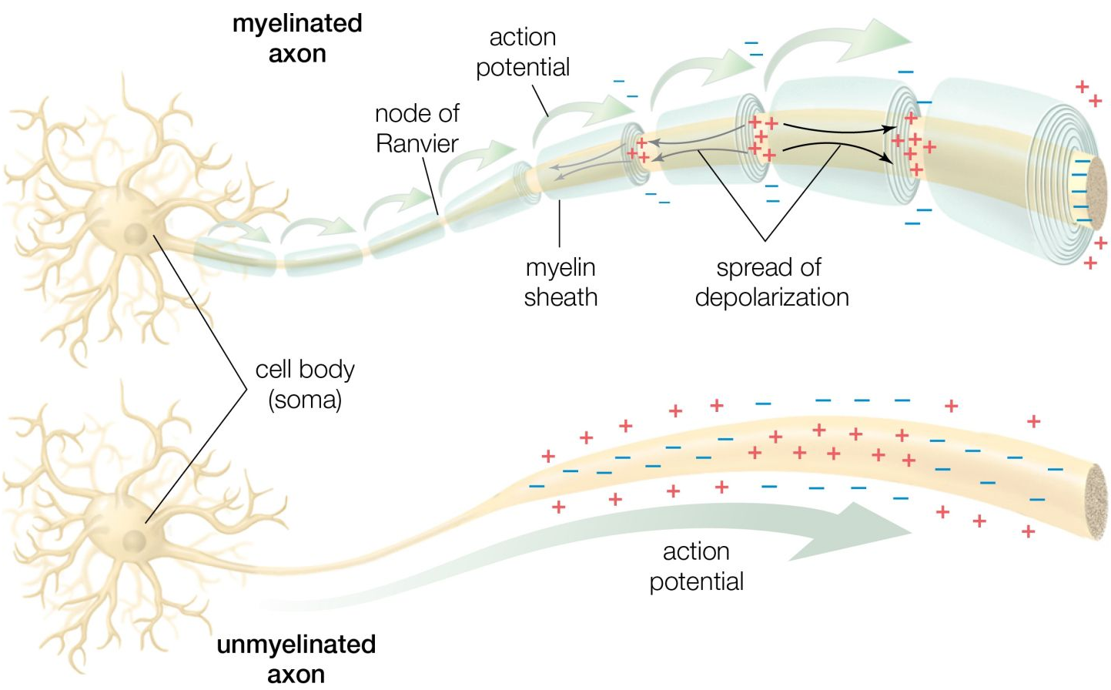
The ACNEI Computational Neuroscience Introductory School
THE AXON TRANSPORT-impulse
Movement of impulse
or current across the
cell axon from cell body
to terminal button
acnei.org

Slide 5
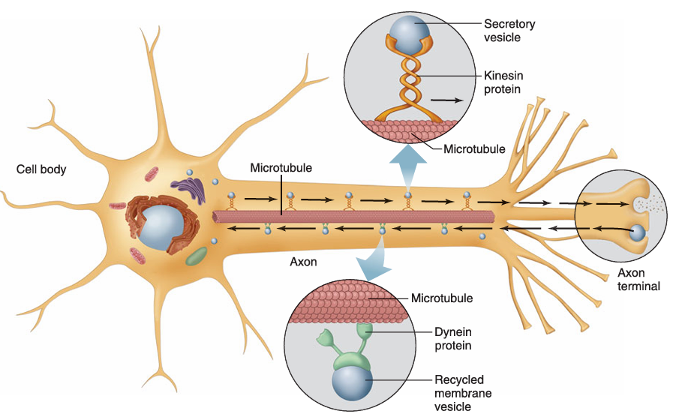
The ACNEI Computational Neuroscience Introductory School
THE AXON TRANSPORT- Neurotransmitters
Anterograde
Types of Axonal Transport
Anterograde
Retrograde
acnei.org
Retrograde

Slide 6
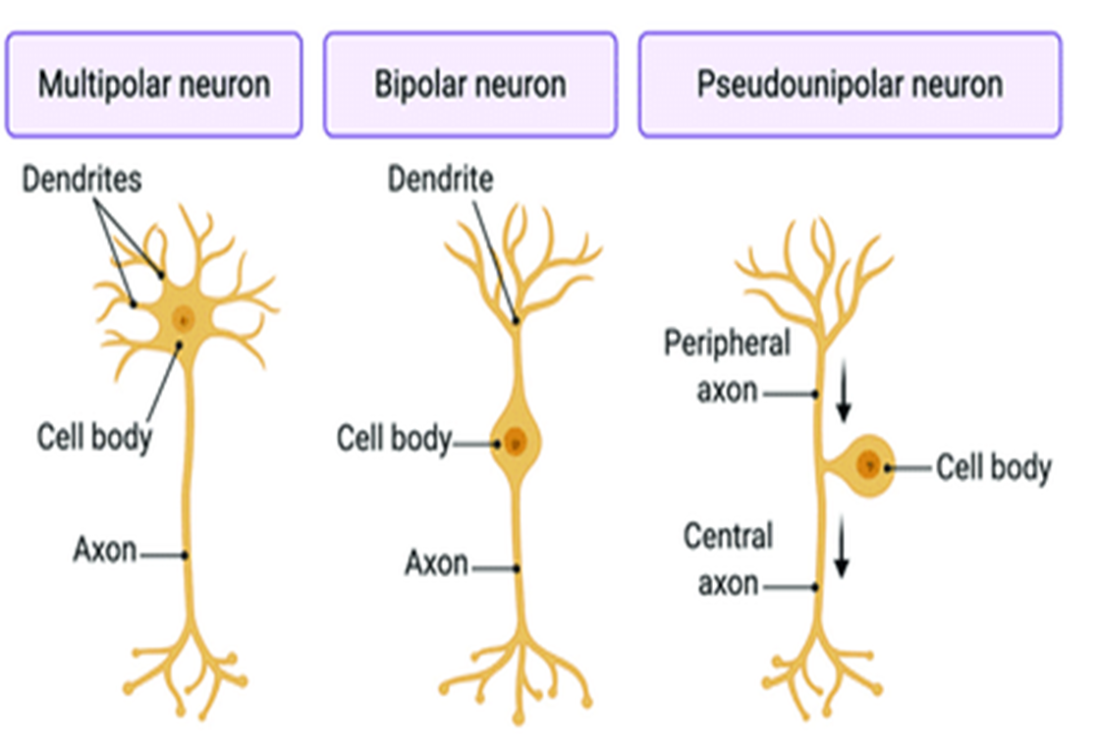
The ACNEI Computational Neuroscience Introductory School
TYPES OF NEURONS
Classification based on branches from Cell Body
acnei.org

Slide 7
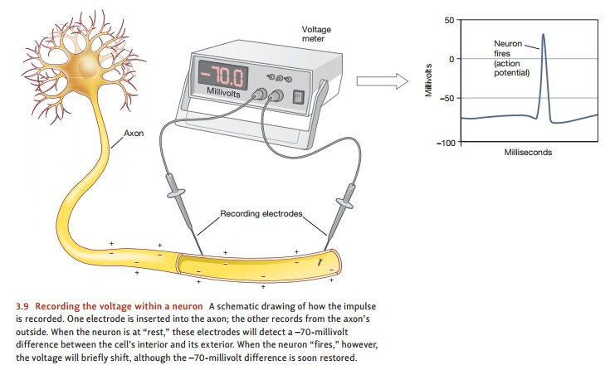
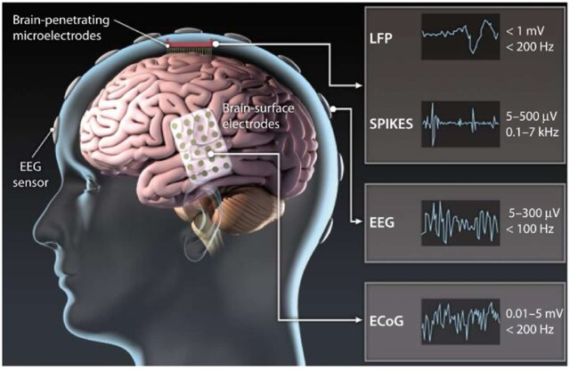
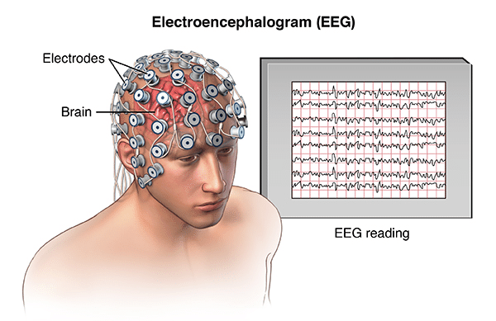
The ACNEI Computational Neuroscience Introductory School
Electrical Recording in a Neuron
We can collect Brain signals through Electrical Recording
acnei.org

Slide 8
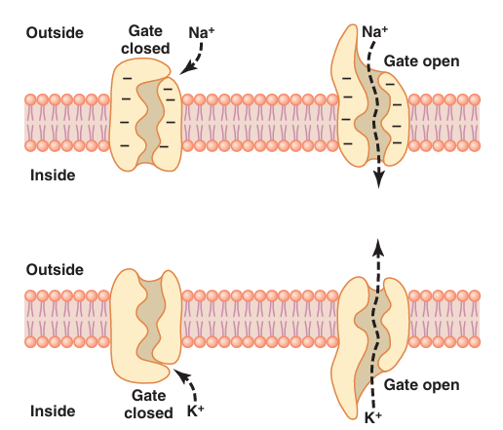
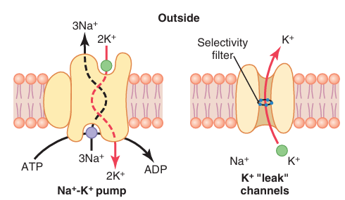
The ACNEI Computational Neuroscience Introductory School
Membrane Channels
Membranes have different ion channels
(Na+, K+) ions
Purpose: Allow movement of ions in and out
of the cell
This ionic movement is responsible for changes in polarity of the cell membrane
acnei.org

Slide 9
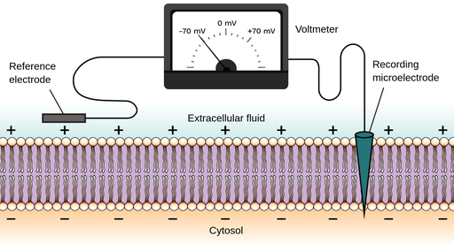
The ACNEI Computational Neuroscience Introductory School
Electrical Properties of Cell Membrane
Concept of
- Membrane Polarity
- Resting Membrane Potential
(RMP)
acnei.org

Slide 10

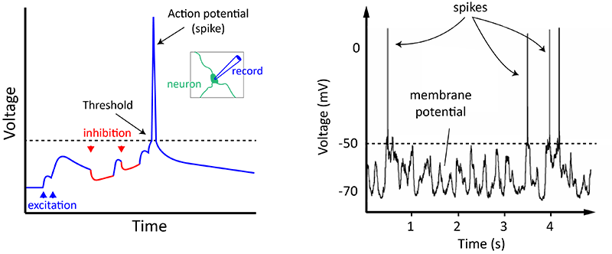
Neuron Spikes
The ACNEI Computational Neuroscience Introductory School
Neurons are essentially electrical devices
There are many channels sitting in the cell membrane (the boundary between a cell’s inside and outside) that allow positive or negative ions to flow into and out of the cell
Normally, the inside of the cell is more negative than the outside;
neuroscientists say that the inside is around -70 mV with respect to the outside, or that the cell’s resting membrane potential is -70 mV
acnei.org

Slide 11
Neuron Spikes
The ACNEI Computational Neuroscience Introductory School
This membrane potential isn’t static
It’s constantly going up and down, depending mostly on the inputs coming from the axons of other neurons
Some inputs make the neuron’s membrane potential become more positive (or less negative, e.g. from -70 mV to -65 mV), and others do the opposite
These are respectively termed excitatory and inhibitory inputs, as they promote or inhibit the generation of action potentials
acnei.org

Slide 12
Neuron Spikes
The ACNEI Computational Neuroscience Introductory School
APs are the fundamental units of communication between neurons
occur when the sum total of all of the excitatory and inhibitory inputs makes the neuron’s membrane potential reach around -50 mV
a value called the action potential Threshold
Neuroscientists often refer to action potentials as ‘spikes’, or say a neuron has ‘fired a spike’ or ‘spiked’
acnei.org

Slide 13
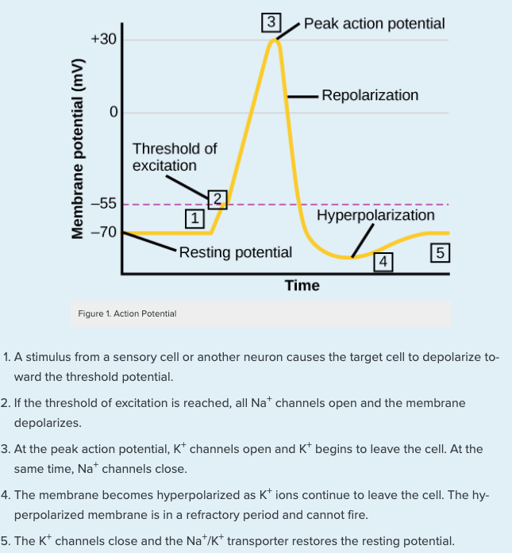
Neuron Spikes
The ACNEI Computational Neuroscience Introductory School
Spikes show rapid changes in polarity of membrane potentials
All vital information is coded within the firing pattern and frequency
Spikes patterns are fundamental to coding in the brain
Phases of Action Potential
Resting Membrane Potential
Depolarization
Repolarization
Hyperpolarization
acnei.org

Slide 14
Neuron Spikes
The ACNEI Computational Neuroscience Introductory School
Action Potential threshold must be reached for a spike to be recorded
Voltage gated channels underlie spikes
There are leaky channels within the membrane
Each neuron will have a ,maximum firing frequency (refractory Period)
All electrical properties of the neuron are subject to change
Phases of Action Potential
Resting Membrane Potential
Depolarization
Repolarization
Hyperpolarization
acnei.org

Slide 15
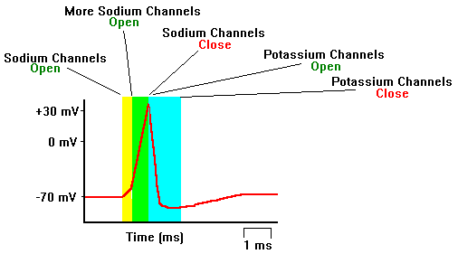
Spikes/Action Potential
The ACNEI Computational Neuroscience Introductory School
Channels involved
Ionic movement
1. Resting Membrane Potential
-Sodium/Potassium Pump
-Potassium Leaky Channels
2. Depolarization
Voltage-gated Sodium channels
3. Repolarization
- Voltage-gated Potassium channels
4. Hyperpolarization
- Voltage-gated Potassium channels
acnei.org

Slide 16
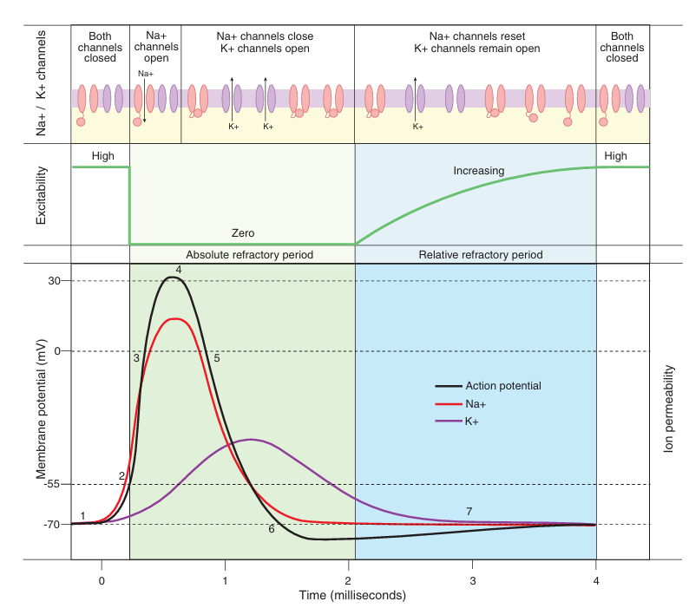
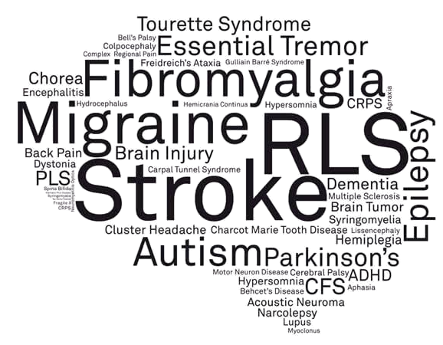
Refractory Period
The ACNEI Computational Neuroscience Introductory School
Neurological disorders are conditions that affect the nervous system, including the brain, spinal cord, and nerves, causing issues with movement, communication, cognition, and other bodily functions.
Diagnosis requires medical evaluation, and persistent or severe symptoms warrant immediate medical attention.
acnei.org

Slide 17
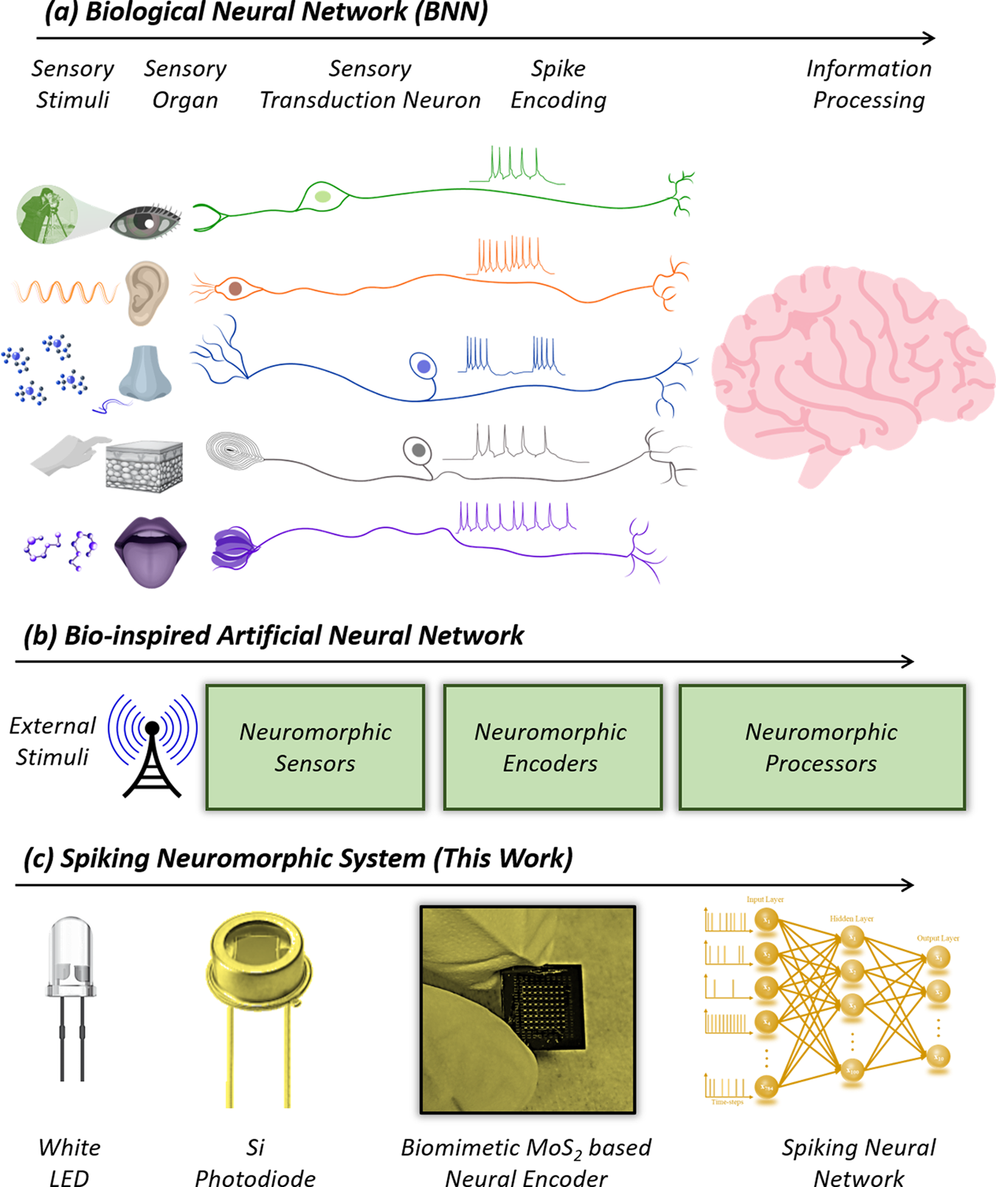

The ACNEI Computational Neuroscience Introductory School
What can Spikes tell us?
We can relate Spiking activity to external stimuli
The function of the neuron in health and disease
How plastic the neuron/network is
The effect of drugs on the neuron
The effect of neuronal manipulations on its properties and activity
A typical nerve cell or neuron
acnei.org
Subbulakshmi Radhakrishnan et.,al 2021
https://doi.org/10.1038/s41467-021-22332-8

Slide 18

Learning
The ACNEI Computational Neuroscience Introductory School
Learning is when the brain takes in new information—from any sensory modality—and either stores it or represents it in a way that modulates future activities
It includes a broad range of tasks like motor training, object recognition, and explicit memory formation
Clearly, this is happening all the time in humans and is arguably the substance of intelligence
I've asked a lot of people how learning works and nearly every time the response is Synaptic Plasticity
acnei.org

Slide 19
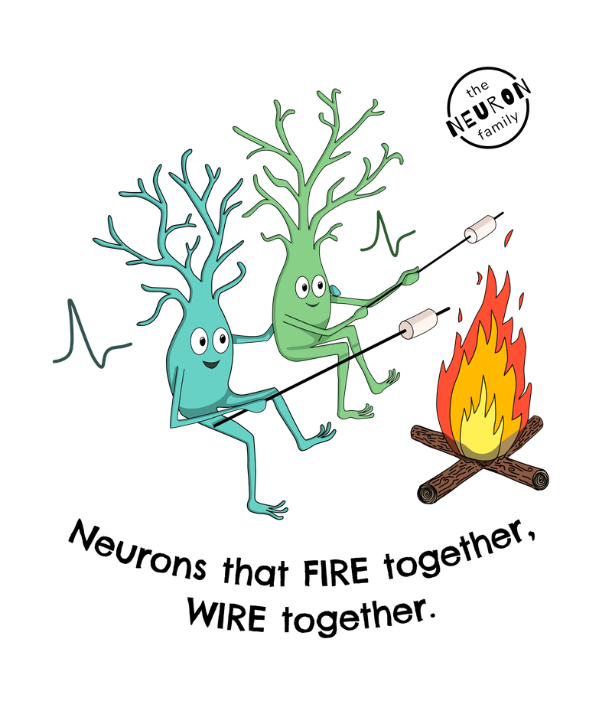
Synaptic Plasticity
The ACNEI Computational Neuroscience Introductory School
Plasticity is the ability of the brain to change and adapt to new information
Synaptic plasticity is change that occurs at synapses
The idea that synapses could change, and that this change depended on how active or inactive they were, was first proposed in the 1949 by Canadian psychologist Donald Hebb
Two proceses
Long-Term Potentiation (LTP)
Long-term Depression (LTD)
Hebbian Principle: cells that fire together wire together
acnei.org

Slide 20
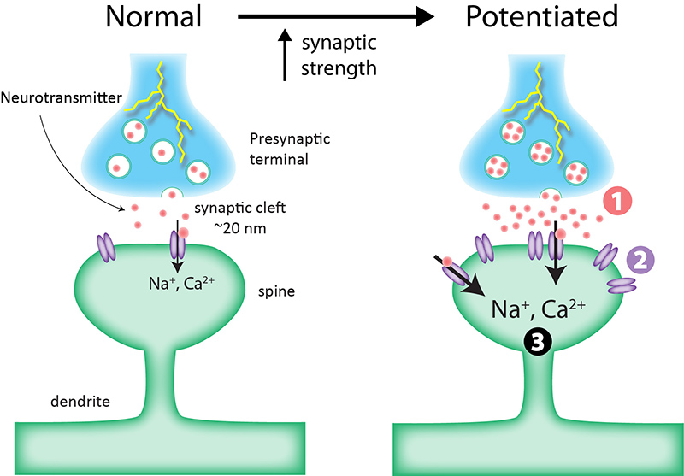
The ACNEI Computational Neuroscience Introductory School
Long-Term Potentiation(LTP)
LTP: persistent strengthening of a synaptic connection
Hebbian principle
Synaptic plasticity can change either:
1) the amount of neurotransmitter released or
2) the number of postsynaptic receptors available
resulting in changes in synaptic strength
Both have the effect of altering how much electrical current flows through the ion channels
Image: Alan Woodruff / QBI
acnei.org

Slide 21
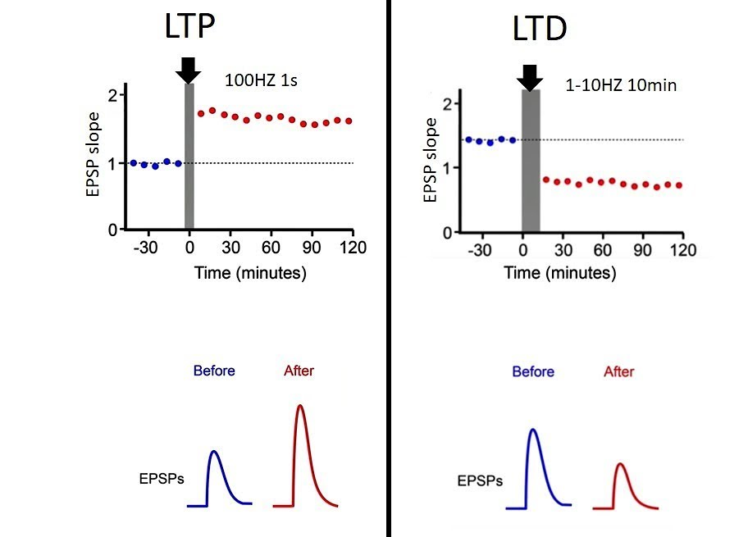
The ACNEI Computational Neuroscience Introductory School
Long-Term Depression (LTD)
LDP: persistent weakening of a synaptic connection
essentially the reverse of LTP
EPSP: Excitatoty Post-Synaptic Potential
acnei.org

Slide 22
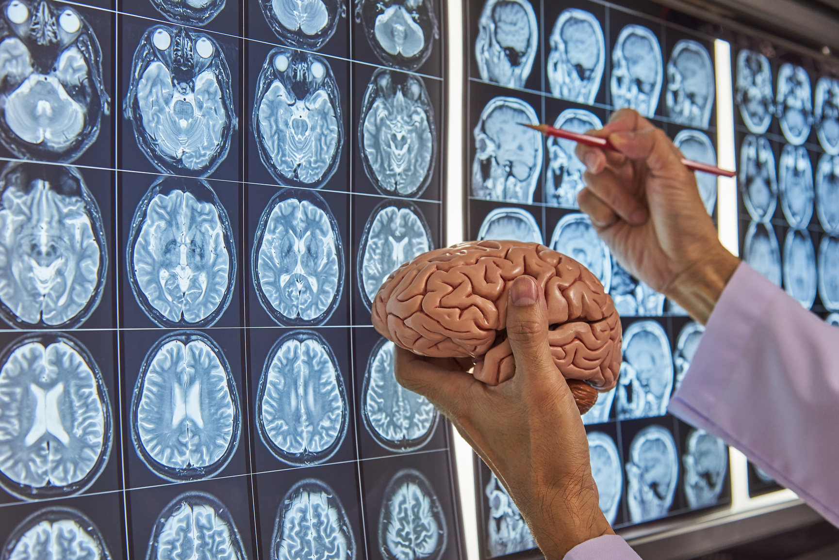
The ACNEI Computational Neuroscience Introductory School
Take-Home Message
Neurons exhibit electrical changes that help us understand the working of the brain
Neuronal properties are plastic
Reminder:
You’ll apply the concepts in this tutorial right after this...
acnei.org

Slide 23

The ACNEI Computational Neuroscience Introductory School
To-Do’s
Review types of synapses: Electrical vs Chemical synapses
How the synapses function
acnei.org

Slide 24
The ACNEI Computational Neuroscience Introductory School
Q &A Session
acnei.org

Slide 25


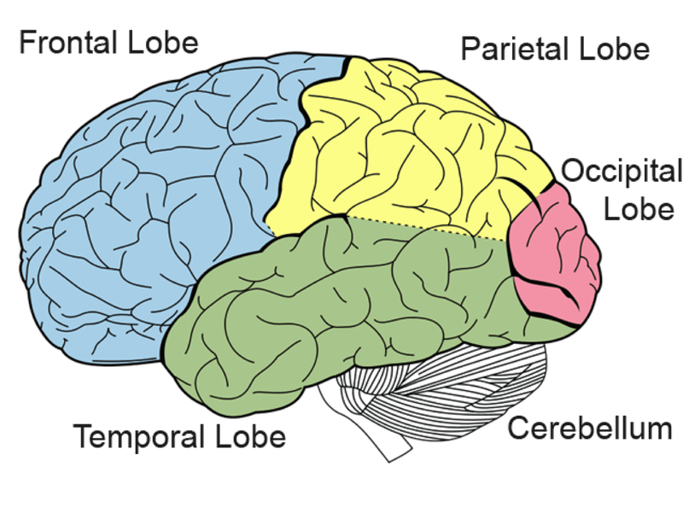




The ACNEI Computational Neuroscience Introductory School
THE CORTEX
Parietal Lobe
Sensory information
Smell, taste, touch, pain
Frontal Lobe
Problem solving, Decision Making
Organizing & Planning
Personality
Emotions, Behaviour & Mood
Occipital Lobe
Process visual information
Visual system
Left to right
Shapes and sizes
Temporal Lobe
Speech, Hearing, Balance
Short term memory
Long term memory
Understand language
Cerebellum
Coordination of voluntary movement
Balance & Posture
Brain Stem
Breathing
Heart rate
Consciousness
acnei.org
Parts of the Brain & Their Functions.
By Martina Anene-Ogbe.

